Slide 1
Online Hotel Booking System

Slide 2
Agenda 1) Project Introduction 2) Project Architecture 3) Technology Platform used for project 4) User Roles 5) Division of work within Team 6) Details of my Contribution 7) Future extensions 8) Conclusion

Slide 3
Project Introduction
Purpose of Project:
This project provides an online platform for the hotel booking . This system provides user interface for service provider to add hotel information and Customer to book Hotel.
Need of Project:
Hotel reservation systems make business easier, they allow hoteliers to work more smartly, accurately and efficiently. It is a highly convenient way for travellers to make a reservation.

Slide 4
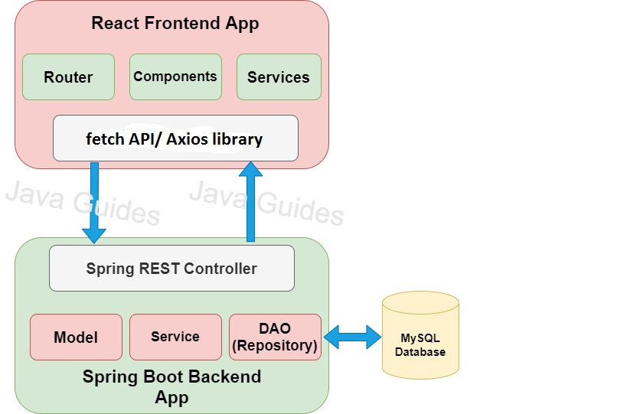
Project Architecture

Slide 5
Technology Platform used for project
Technologies Used:
Java
Spring Boot REST API
JPA
React JS
Bootstrap
MySQL

Slide 6
User Roles
Users:
Customer
Service Provider
Admin
User Roles:
Customer:- Create Account, Book Room
Service Provider:-Create Account, Add Hotel
Admin:-View Users, View Hotels, Delete Users , Delete Hotels

Slide 7
Division of work within Team

Slide 8
Future extensions
In Future Customer can get Information about Hotel and status through Email, Whatsapp , as well as location details.
We can use payment Gateway for money transaction.

Slide 9
Conclusion

